Slide 1
IHO - NIPPON FOUNDATION Alumni Seminar
29 – 31 October 2019, Singapore

Slide 2
Administrative Overview of the CHART Project
Overview
Overall Administration
UKHO Administration

Slide 3
Administrative Overview of the CHART Project
JANUARY
First Annual Coordination Meeting (Taunton)
Review of past course
Plans for next course
Drafting of IHO Circular Letter
inviting participation
Notes:
1st Annual coordination meeting takes place in January each year in the UK and is held at the office of the UKHO. Thee meeting and is attended by the Japan Hydrographic and Oceanographic Department, the IHO Secretariat, and UK HO Training team.
At this meeting a review of the previous years course is conducted which covers a training and financial overview and also considers lessons learned.
Plans for the next course are discussed and start and end dates are agreed along with the selection criteria against which applications will be reviewed. These details are included in the Circular Letter drafted by the IHO Secretariat that is issued in January inviting applications for the forthcoming IHO – Nippon Foundation CHART course. The closing date for application is March of the same year.

Slide 4
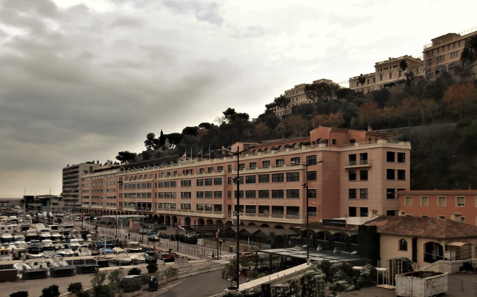
Administrative Overview of the CHART Project
APRIL
Second Annual Coordination Meeting (Monaco)
Selection panel meets to
select 7 students
Drafting of IHO Circular Letter
inviting participation
Notes:
In April following the closing of the application window, the 2nd Annual coordination meeting is held in Monaco and the offices of the IHO.
This meeting is held to select the 7 students for the course. All of the applications submitted are reviewed against the selection criteria, ensuring a fair process. The shortlisted candidates then undertake a telephone interview for final suitability assessment. Once the 7 individuals have been agreed a circular Letter is drafted by the IHO and issued announcing their success.
In 2019 31 applications were received for the 7 places, highlighting the regard that this opportunity is held in.

Slide 5
Administrative Overview of the CHART Project
MAY
UK Hydrographic Office
Melanie Davis (International Training Administrator)
Joining instructions
Flights and accommodation
Security arrangements
Notes:
From April the UKHO administration commences. As the UKHO is part of the ministry of Defence security clearance must be obtained to allow the participants into the Hydrographic Office. This administration is undertaken by Melanie Davis our International Training Administrator, who many of you know.
Security forms are sent to and completed by selected participants who then must forward them to the Embassy for the final completion and then sent onward to IVCO, The International Visits Control Office.
Once approved by the IVCO department the UKHO is informed confirming that participants are permitted to enter the establishment. Melanie commences logistical administration providing flight itineraries and booking confirmation both in Taunton for the duration of the course and in London for arrival and departure.

Slide 6
Administrative Overview of the CHART Project
SEPTEMBER
UK Hydrographic Team
Icebreaker event on arrival in Taunton
Provides daily transport
Notes:
In early September the Cat B IHO- Nippon foundation course begins. Students are transported from London to Taunton where they are met by members of the training team who provide an acquaint to the new participants. This includes a brief tour of Taunton to provide some situational awareness and an informal icebreaker lunch allowing introductions to be made.

Slide 7
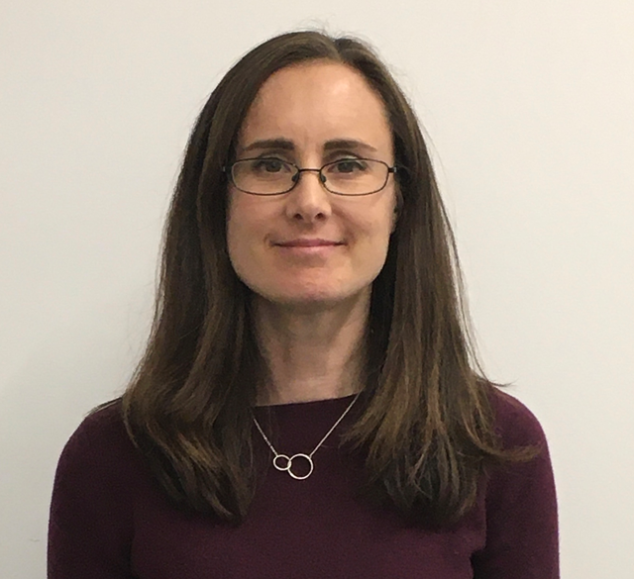
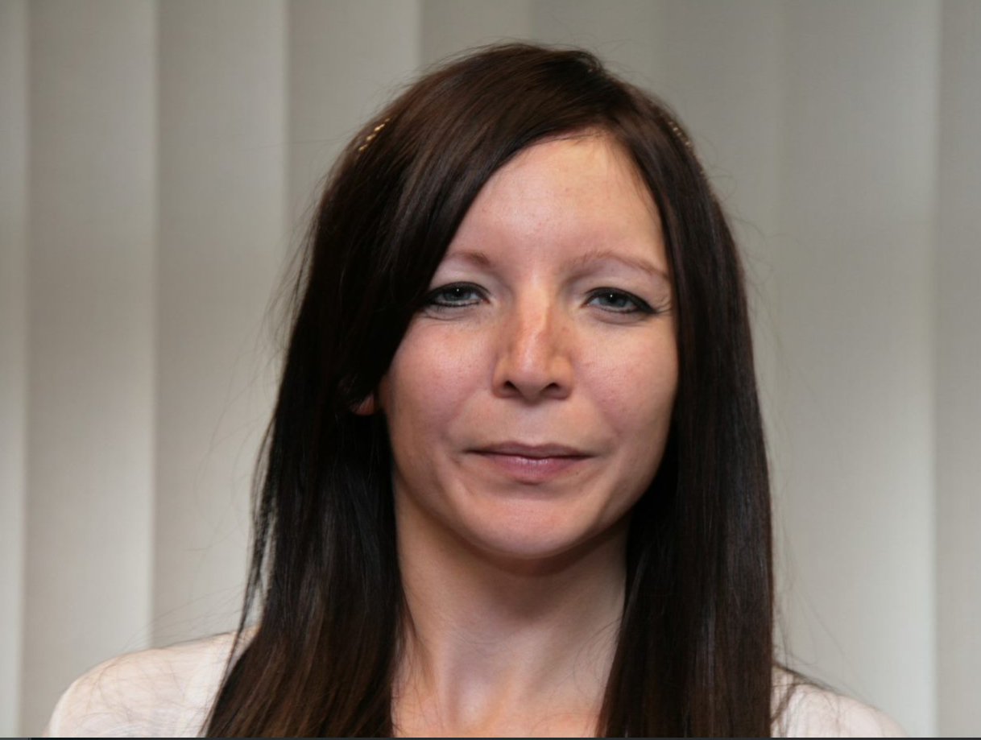
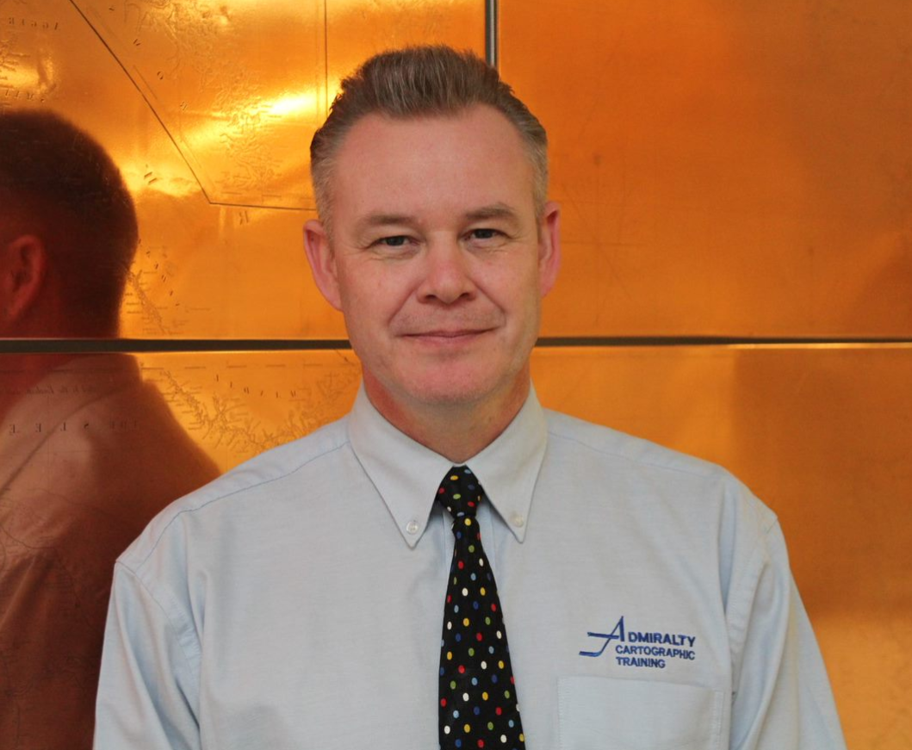
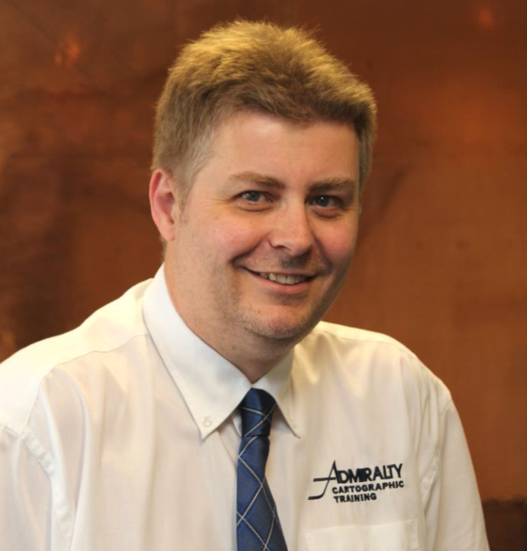
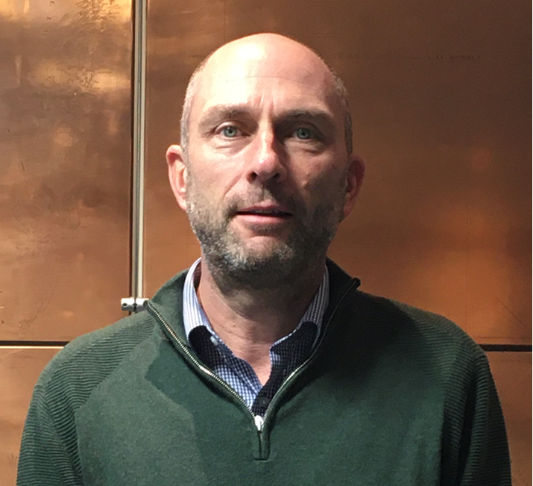
Administrative Overview of the CHART Project
UK Hydrographic Office International Training Team
Qualified Adult educators
Vast experience in Digital and Paper Nautical Cartography
Notes:
The UKHO International Training Team is made up 6 members, myself , Melanie Davis and our 4 International Trainers. Mr Chris Booth, Ken Blagdon, Kevin Bagwell and currently we have Richard Coyles in our team following Derek Aldridges retirement. The training team are all qualified adult educators and in the team we have over a 125 years experience in the Digital and paper nautical cartography and product maintenance.

Slide 8
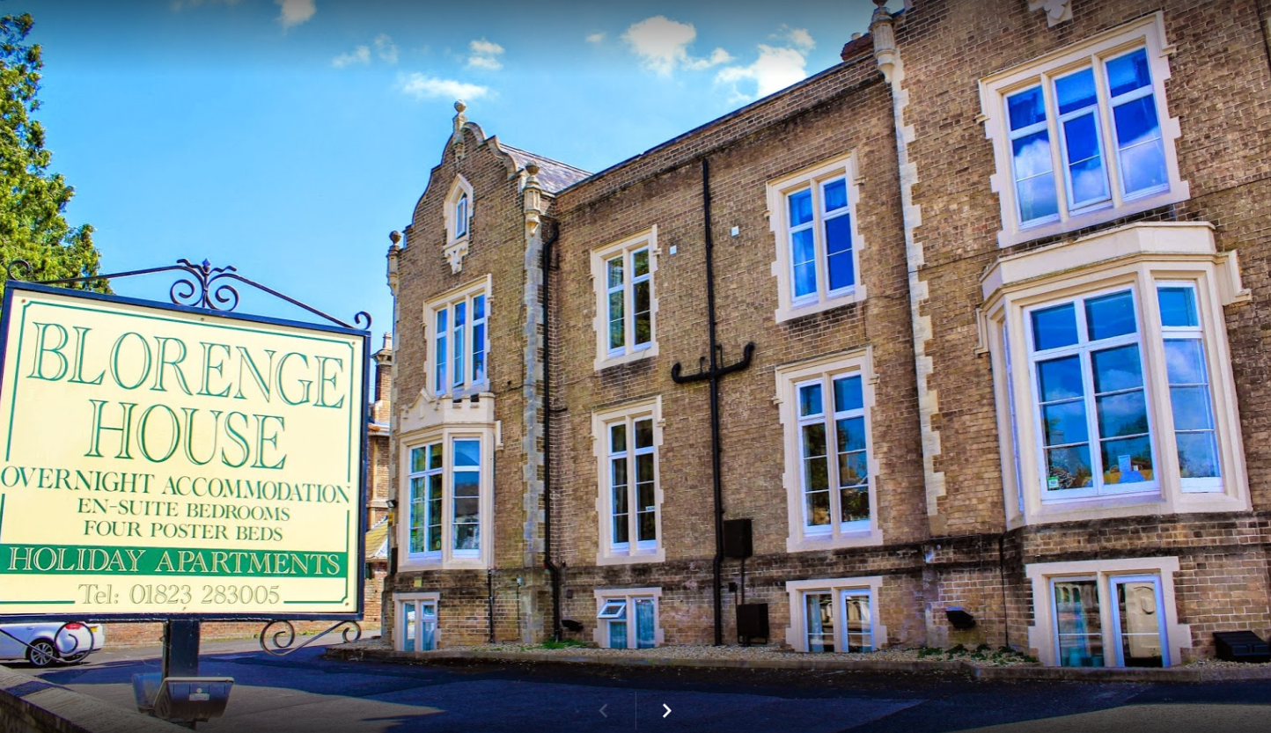
Administrative Overview of the CHART Project
Accommodation - Blorenge House
Central location
Access to kitchen facilities
Access to laundry facilities
Notes:
Accommodation for the course is at the Blorenge Hotel, a family run local hotel that is located close to the centre of Taunton. This hotel, provides a relaxed atmosphere and allows access to kitchen and laundry facilities which helps to reduce the costs placed on individuals during their stay in Taunton.
Some of you may still recall the cooked breakfasts that get you through the dark UK winter!!

Slide 9
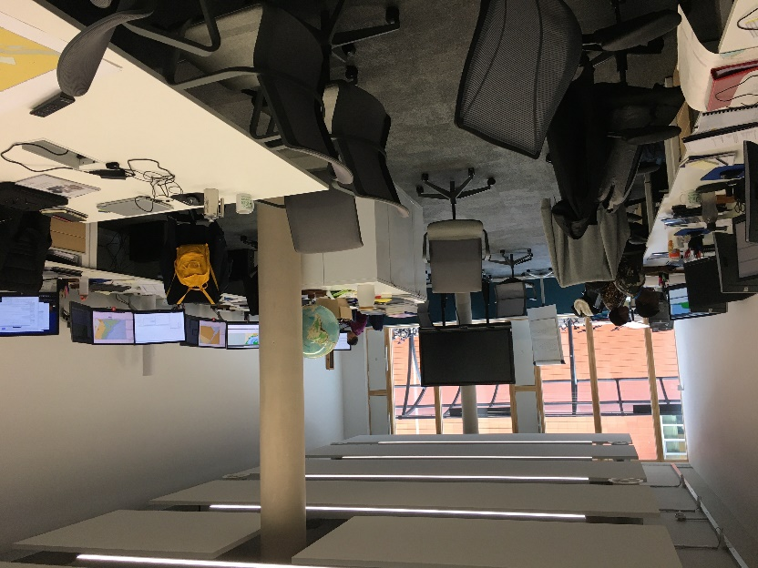
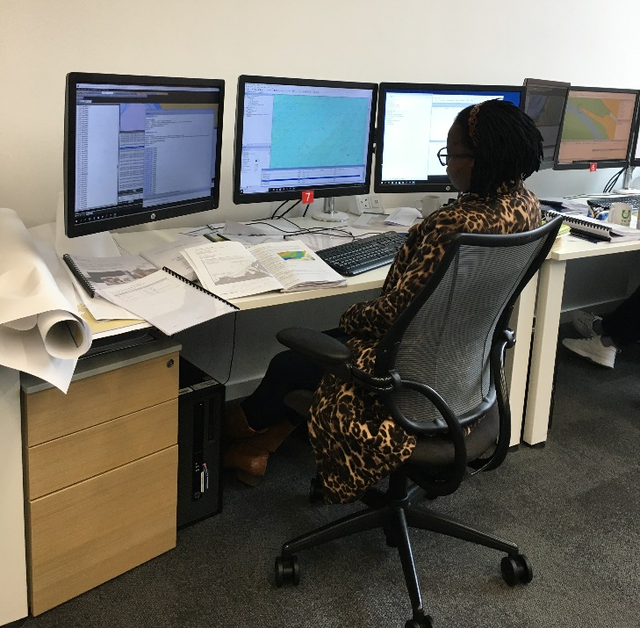
Administrative Overview of the CHART Project
International Training Facilities
3 screens
Break out areas
Windows!!
Notes:
Earlier this year the UKHO staff moved into our new office. Included in the new build is a new international Training room which provides an excellent environment for learning. Centrally located the students feel part of UKHO and to the envy of more recent Nippon courses the room does have windows!

Slide 10
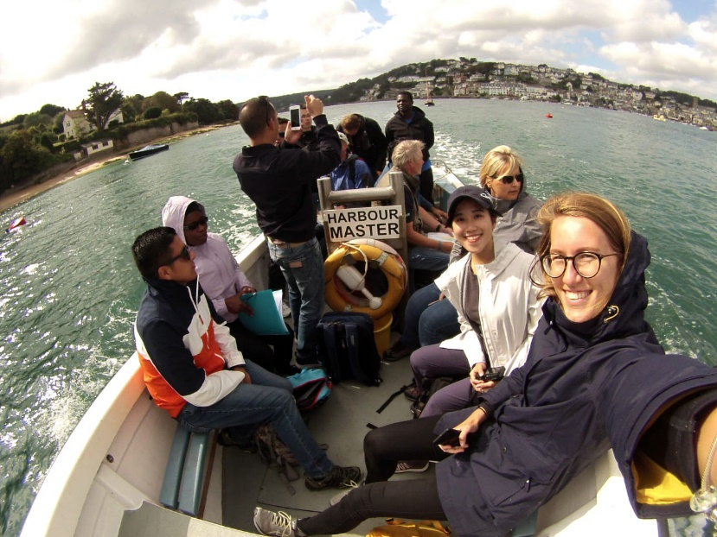
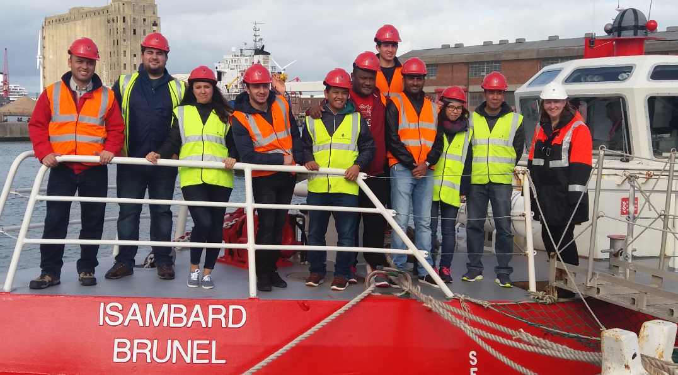
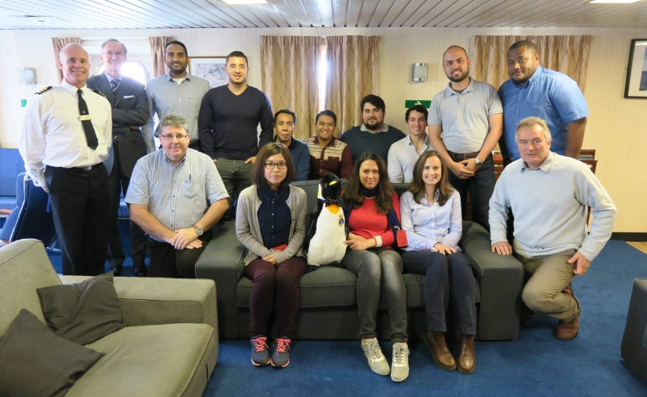
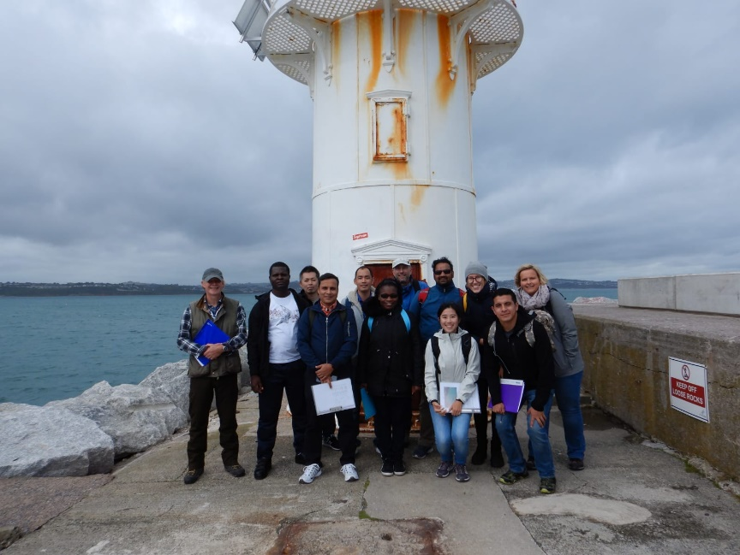
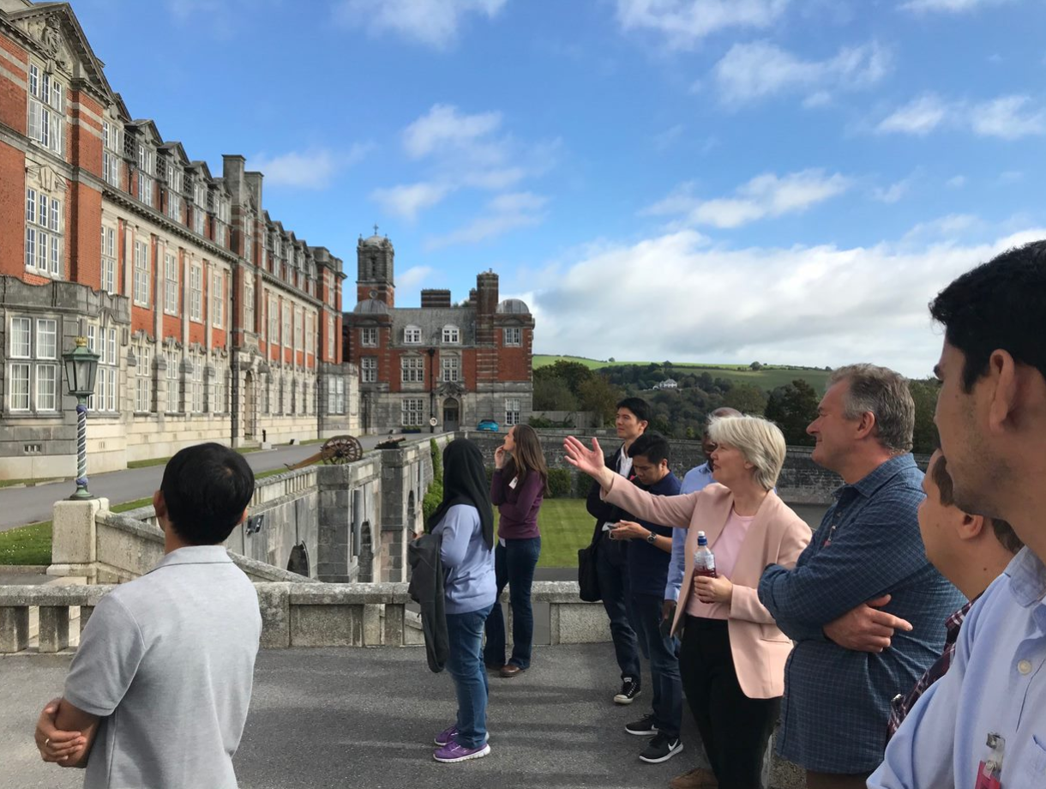
Administrative Overview of the CHART Project
Field Trips
Supported by:
Bristol Port Authority
Devonport Naval Base
Salcombe Harbour Master
Notes:
The success of this course whilst in Taunton is not just down to the administration by the UKHO but also due to the support provided by external organisations such as the Bristol Port Authority, the Royal Navy and Salcombe Harbour who host visits by the participants providing extra depth and value to the course.

Slide 11
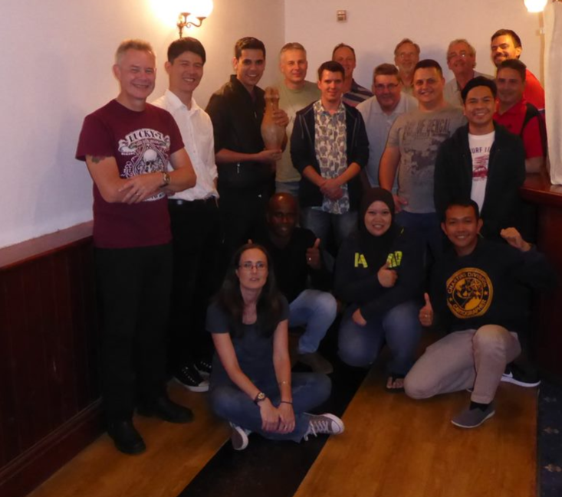
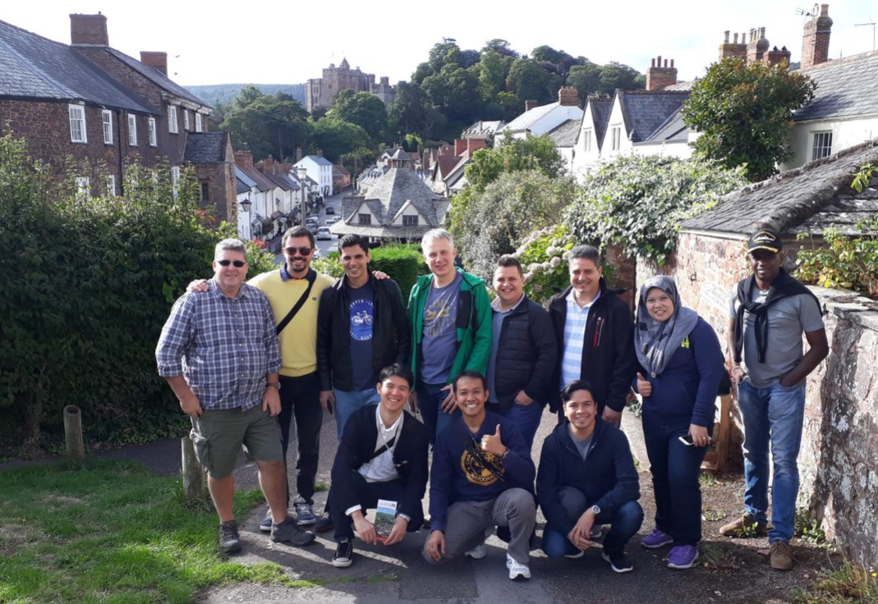
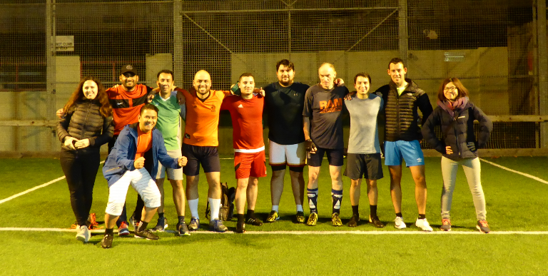
Administrative Overview of the CHART Project
Its not all hard work!
Social
Events
Cultural
Visits
Notes:
And whilst the course is hard work and calls for the participants to apply themselves it is not all hard work. A number of social events are administered by the UKHO to try to ease the long time that we appreciate individualts are parted from their families.
The UKHO will also assist with booking any transport that people may wish to book for private excursions.

Slide 12
Administrative Overview of the CHART Project
Religious/Faith requirements met
Arrangements for dental and medical care if required
Transport arrangements met
Duty of Care throughout
Notes:
Other Support that the UKHO provides includes the provision of religious and faith requirements, both on site at the UKHO and in the local area.
Arrangements for any medical care that may be required and duty of care throughout. On behalf of the training team I can say that the participants are our extended family.

Slide 13
Administrative Overview of the CHART Project
Course Evaluation
Bi-Weekly
End of course
Individual Student Reports and Overall course report
Postage of training material
Notes:
To ensure that the course remains relevant and any issues are addressed as soon as possible, bi-weekly reviews are undertaken and an overall course evaluation is completed at then end of course that also addresses the administration of the course.
Following completion of the course student reports are written with final project marks and these are sent to the participating offices. An overall course report is completed and submitted for review at the subsequent meeting in January.

Slide 14
Administrative Overview of the CHART Project
Thank you

